Slide 1
Hybris Data Modeling

Slide 2
Agenda
Java vs Hybris
Introducing the Hybris Type System
Item Modeling in Hybris
Hybris Type System Automatic Generation
Example of Item Modeling in Hybris
Collections & Relations
Deployment

Slide 3
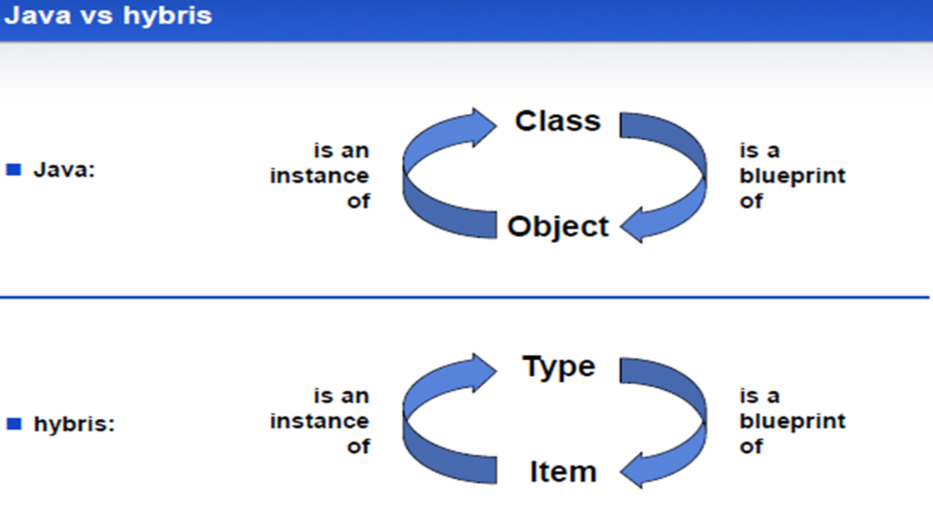
Java vs Hybris

Slide 4
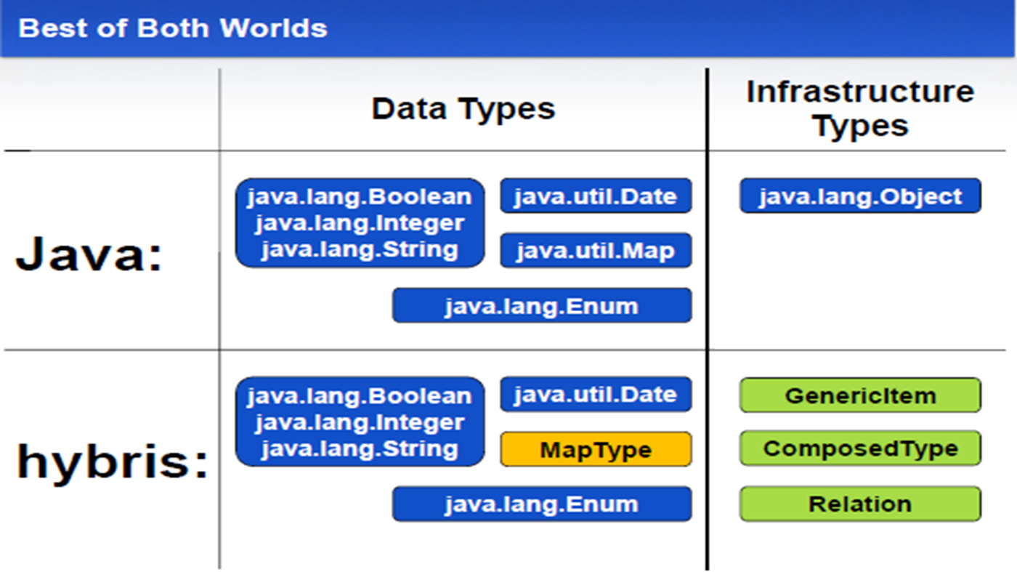
Java vs Hybris (Continued)

Slide 5
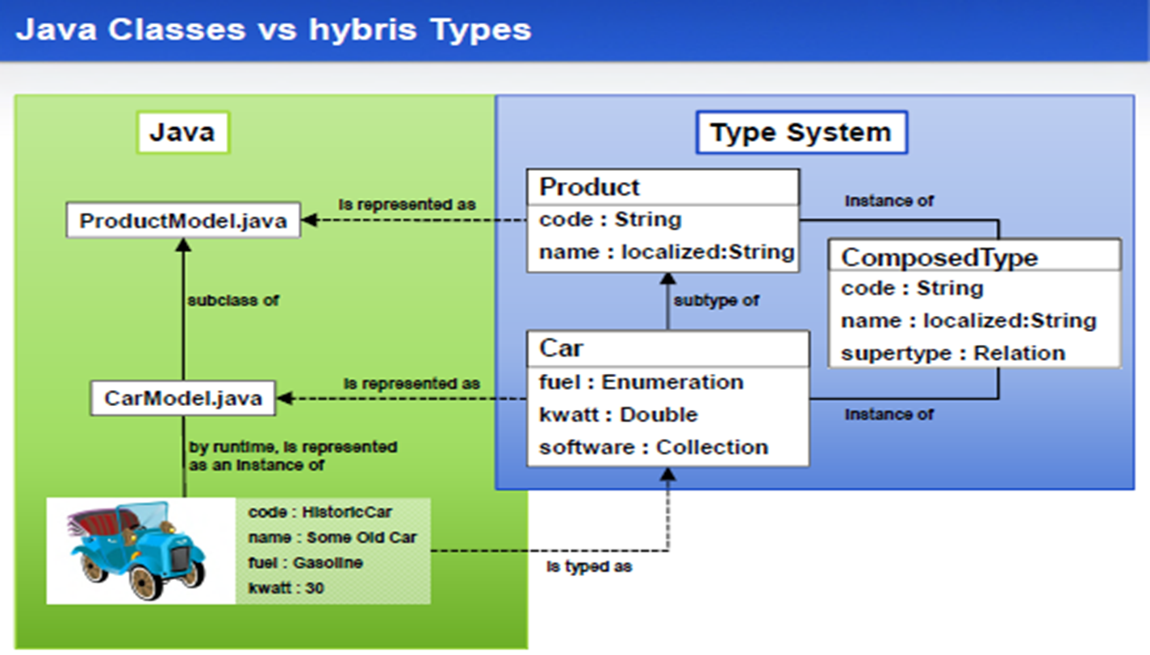

Java Vs Hybris (continued)

Slide 6
Introducing the Hybris Type System
The Type System is one of the most important concepts of the hybris Commerce Suite. Every object stored in the platform is one type or another, depending on the kind of object. A type is a template for objects, it defines the product data the object may carry and what other objects the object is related to. Types also make product data persistent by categorizing the data and relating it to database fields.
The hybris Commerce Suite makes use of a system of so-called types to organize the data it holds - be it product information, customer data, addresses, or orders.
Items within the hybris Commerce Suite are made persistent by writing values into a database. Within the database, the values are stored in tables

Slide 7
Type System (continued)
The hybris Commerce Suite allows to explicitly define the database tables in which the values of instances of a given type will be written. This process is referred to as deployment.
Deployment is inherited from a type to its subtypes. The deployment that is active for a given type is the deployment specified closest to the type in the type's hierarchy
The topmost deployment is GenericItem, which is therefore the default deployment. That means that if a type has no explicit specification of deployment, that type's instances will be deployed in the same table as GenericItem.
To specify a deployment, add a <deployment table="tablename" typecode="typecode_number"/> tag to the type definition in the items.xml

Slide 8
Types used in hybris
Automiuc Types:
Represents Java value objects which are mapped to database types
Java Primitives: int
Wrapper: Integer
Some Reference types: java.util.Date
CollectionType:
Represents a typed collection
CollectionTypes are based on the Java Collection class. Via the type attribute in a CollectionType's definition.
MapType:
Represents a typed Map
ComposedType:
Composed object of other hybris types
Java Primitives: int Wrapper: Integer Some Reference types: java.util.Date
EnumerationMetaType :
ComposedType which describes enumerations
RelationType: ComposedType which describes binary relations between items

Slide 9
Attributes of Composed type
An attribute in hybris multichannel suite can be reference to any of the below mentioned ones.
A composed type. (for example the picture attribute is of type Media.)
A basic java type, called an “atomic type” (for example, the code attribute is of type java.lang.String)
It can have localized name and description.
It can have default value.
Note: All these types and its attribute should be defined in the <extension>-items.xml file only. This is because hybris reads only extension specific items.xml for the data model creation.

Slide 10
Composed Type vs Atomic Type
An atomic type is a value that has direct correspondence on the data base. For example, java.lang.String matched on to VARCHAR.
Logically, a composed type in hybris consists of references to individual items. For example: products can reference pictures and categories etc.
Technically, composed type indicates that the value is not stored as ”flat” value such as VARCHAR, but as primary key (PK) value.
In practice, on the database an instance of type Product will consists of a combination of PKs and /or atomic types.

Slide 11
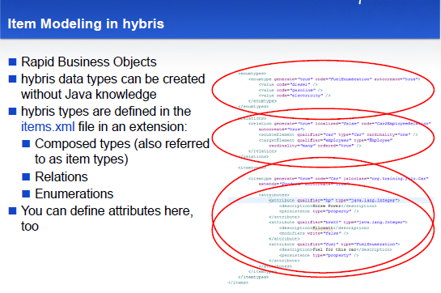
Item Modeling in Hybris

Slide 12
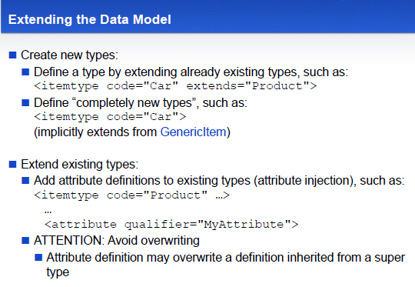
Item Modeling in Hybris (Continued)

Slide 13
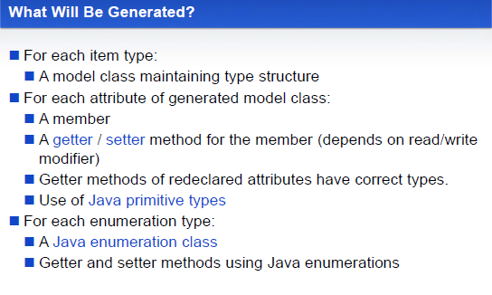
Item Modeling in Hybris (Continued)

Slide 14
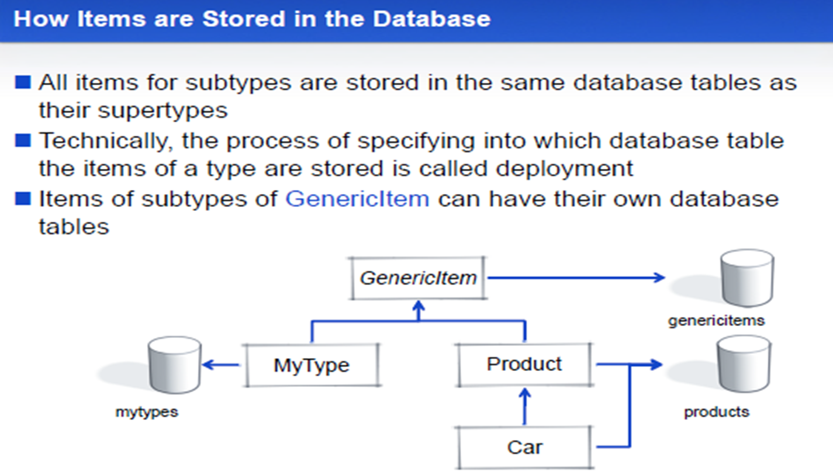
Item Modeling in Hybris (Continued)

Slide 15
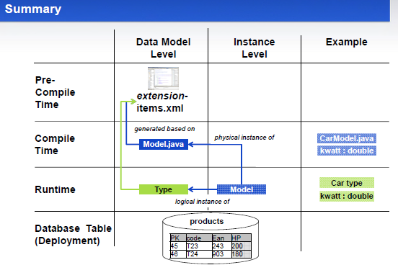
Summary

Slide 16
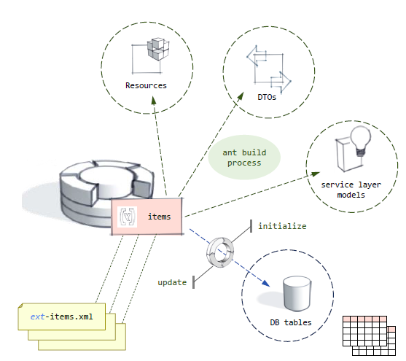
Type System Automatic Generation
Hybris item definitions are
found in each extension's
extensionName-items.xml
The ant process assembles
type definitions and
generates Models, DTOs,
and Resources.
Hybris also creates the
required tables.
Invoking initialize or
update creates the
required table.

Slide 17
Example of Item Modeling in Hybris
Extending type

Slide 18
Example of Item Modeling in Hybris Cont..
Add Attributes

Slide 19
Example of Item Modeling in Hybris Cont..
Add Enumerated types

Slide 20
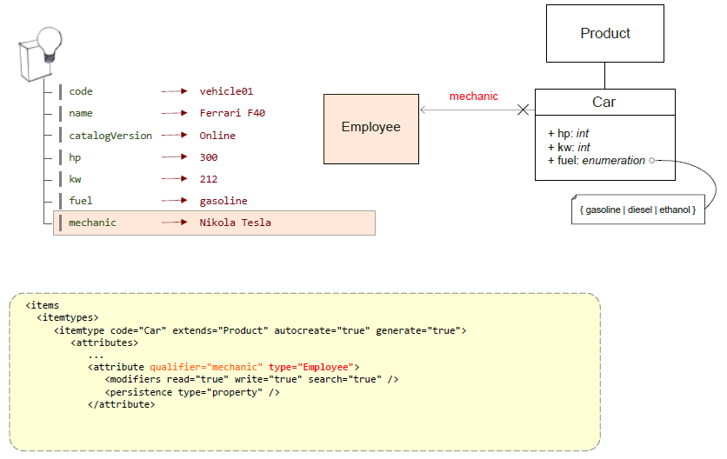
Example of Item Modeling in Hybris Cont..
Composed Type reference

Slide 21
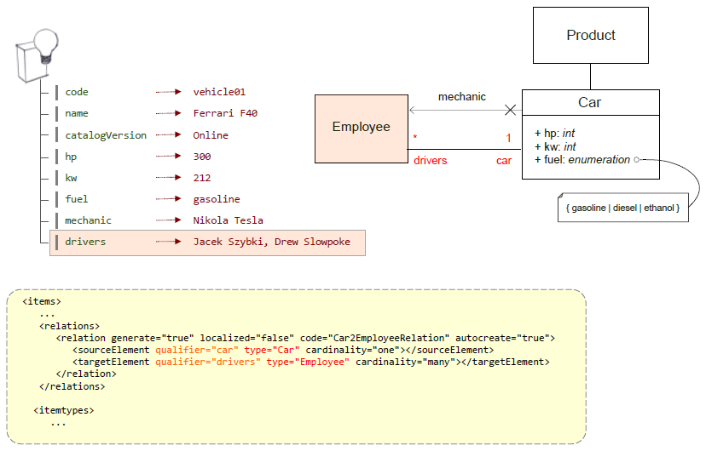
Example of Item Modeling in Hybris Cont..
Create Relations

Slide 22
Collection Types
A Collection Type contains a typed number of instances of types - a dozen Strings, for example. A CollectionType has a unique identifier (referred to as code) and a definition of the type of elements it contains (elementtype). This type definition may include any type of item within the hybris Commerce Suite - even other CollectionTypes.
Can be used as attribute type of a ComposedType
Allows you also to define AtomicTypes collections
Performance considerations: Accessing, Searching
Database integrity considerations
CollectionTypes are based on the Java Collection class.

Slide 23
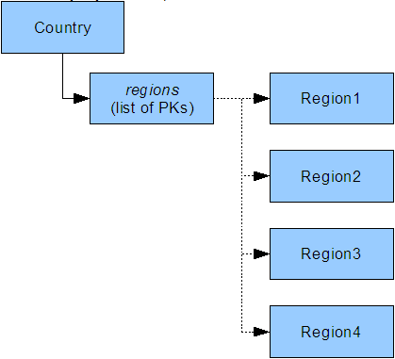
Collection Types (Continued)
There are two types of relations that you can build with CollectionTypes.
one to many
many to one
One-to-many relations (1:n):
keep links to the respective values via an attribute on the source item - via a list of Primary Keys, for example.

Slide 24
Collection Types (Continued)
In the graphic, the Country type has an attribute regions that stores a list of the PKs of the regions.
If the CollectionType contains AtomicTypes, the values are stored as binary fields in the database.
If it stores a collection of items, then those items' Primary Keys (PKs) are stored in the database in string form - a list of PKs, basically.
As all the values of one CollectionType instance are stored as one single field, reading in and writing the values is quite fast as it is done in a single database access (especially with caching). Processing them, however, is more delicate - for three reasons

Slide 25
Collection Types (Continued)
If a collection contains a lot of PKs, the field value may reach the maximum length of field for the database implementation and entries may get truncated. That means that you can only store values of a certain length in that database field and every bit on information beyond that length will get lost.
As the database entry only contains the PKs (in other words: links to items) and not the items themselves, you cannot run database searches on the entries directly. Instead, you need to run searches in memory via Java, which is often slower than searching on the database directly.
If a single CollectionType instance has several AtomicType entries that match a search query, you won't be able to detect the exact number of matches from the database directly.

Slide 26
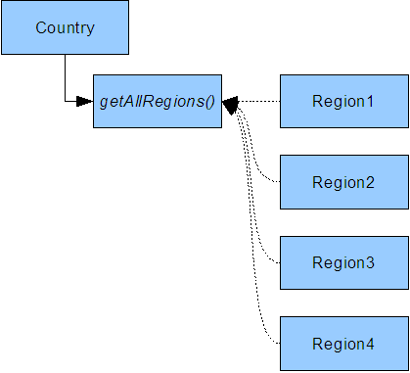
Collection Types (Continued)
Many-to-one relations (n:1):
store the attribute values at the respective target items and have a getter method at the source type to retrieve the values.

Slide 27
Collection Types (Continued)
In the graphic, Country has a getter method called getAllRegions() that runs a FlexibleSearch statement on the database to find all instances of Region.
Unlike the one-to-many kind of relation represented by a CollectionType, this kind of relation
is better performance-wise as the results of FlexibleSearch statements are cached by the hybris Commerce Suite.
does not suffer from a field length limitation as the relation is not established via an attribute and, therefore, no PKs are stored directly.
requires implementing the getter method (via the FlexibleSearch statement).
As CollectionTypes have technical limitations that make modelling n:m relations delicate, hybris recommends using RelationTypes to model complex correlations.

Slide 28
Enumeration Types
EnumerationTypes (EnumTypes for short) map a pre-defined verbatim value to another, internal kind of value. These are Very much like the Enum concept in Java or C.
EnumerationTypes are ComposedTypes and handle values in a special way: the values are also their instances.
Therefore, an EnumerationType called color with the values red, green, and blue has three instances: red, green, and blue. This kind of type is useful for attributes whose values only have a limited number of choices (yes or no, for example).
For more info, please check below url.
https://wiki.hybris.com/display/release5/Working+with+Enumerations

Slide 29
Map Types
A Map Type is a typed collection of key/value pairs. For each key (referred to as argument), there is a corresponding value (referred to as return type). The direction of mapping is always argument -> return value.
A very common use of MapTypes is localized values - values that may differ in every language available in the system, like product descriptions in German and English.
For details on specifying MapTypes, please refer to the MapType section of the items.xml documentation.

Slide 30
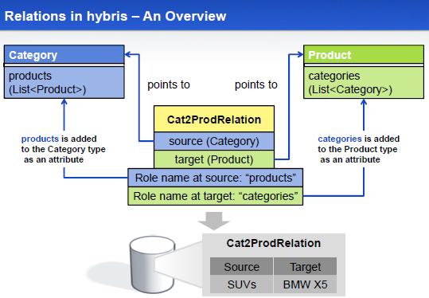
Relations

Slide 31
Relations (Continued)
To model dependencies between various numbers of items on both dependency sides, RelationTypes are the way to go.
They represent n:m relations in the hybris Commerce Suite. RelationTypes allow you to reflect scenarios like various products belonging into several categories and vice versa (as in the graphic).
Internally, the elements on both sides of the relation are linked together via instances of a helper type called LinkItem. LinkItems hold two attributes, SourceItem and TargetItem, that hold references to the respective item (as in the graphic).
For each entry within a relation (in other words, for each link from one item to another), there is a LinkItem instance that stores the PKs of the related items

Slide 32
Relations (Continued)
LinkItem instances are handled transparently and automatically by the platform: On the API level, you only need to use the respective getter and setter methods.
If you delete an item from a relation, neither the item you seem to delete nor its related item is deleted, only the LinkItem is removed.
In other words, both the source item and the target item remain, only the link between them is removed.
When the platform runs a search for either side of a RelationType, it runs through all the relation's LinkItem instances and returns a Java Collection that contains the values.

Slide 33
Relations (Continued)
The hybris Commerce Suite sorts RelationType instances in source-to-target direction by the order the individual relation entries were created.
The target-to-source direction is not sorted by the platform, therefore the order of its results may vary depending on the database you use (that is, without any sorting by your web application or the SQL statements).
RelationType section of the items.xml documentation.

Slide 34
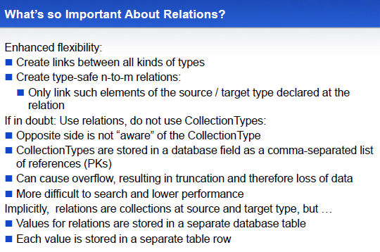
Relations (Continued)

Slide 35
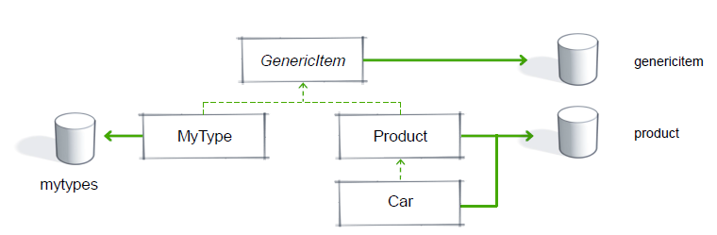
Deployment
Object Relational Mapping - Storing objects in the DB
By default, items for a given type are stored in the same database tables as its supertype
Specify any item type's deployment to store its items in its own db tables.
hybris recommends that deployment be specified for the first layer of GenericItem subtypes
Consider carefully the performance implications of specifying deployment for other item types
Set build.development.mode = true in local.properties to mandate that all direct children of GenericItem have deployment specified.

Slide 36
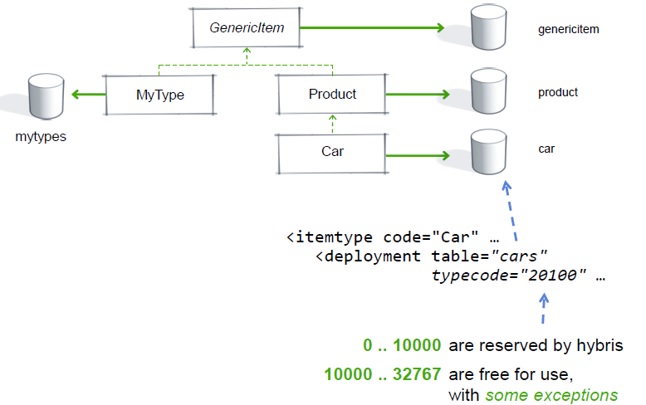
Deployment Cont..
Object Relational Mapping – Deployment Example

Slide 37
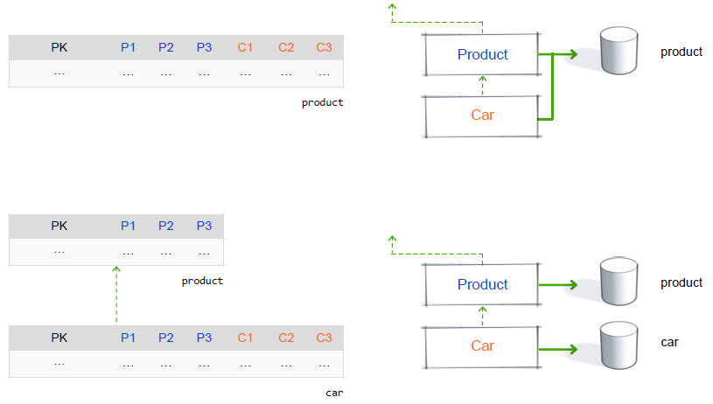
Deployment Cont..
Object Relational Mapping – Table Structure

Slide 38
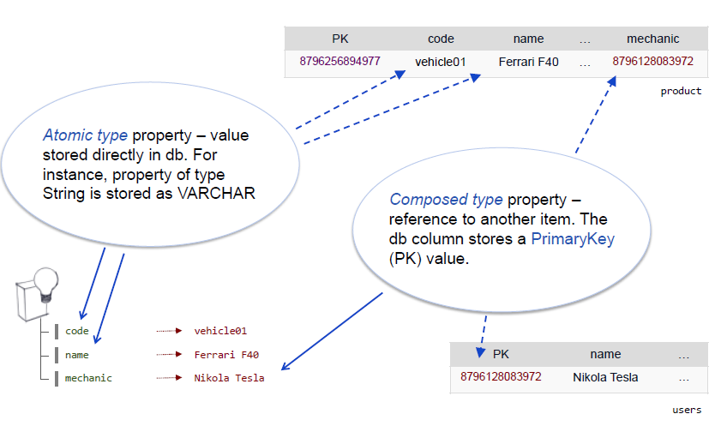
Deployment Cont..
Object Relational Mapping – Attributes of a (Composed) Type

Slide 39
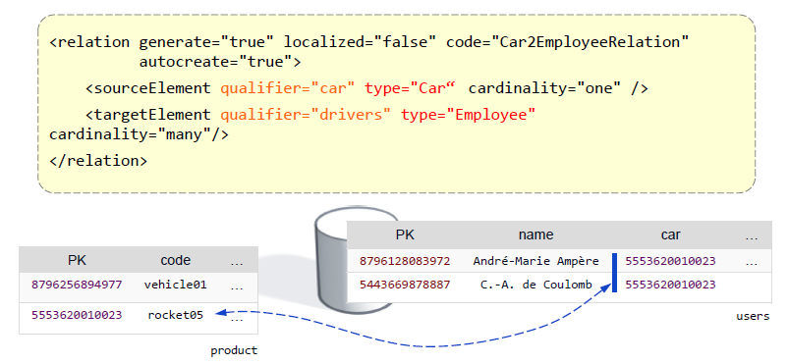
Deployment Cont..
Object Relational Mapping – Deployment of Relations One – Many
Additional column at the many side which holds the PK of the One side
Users table from the example below would have an additional column car

Slide 40
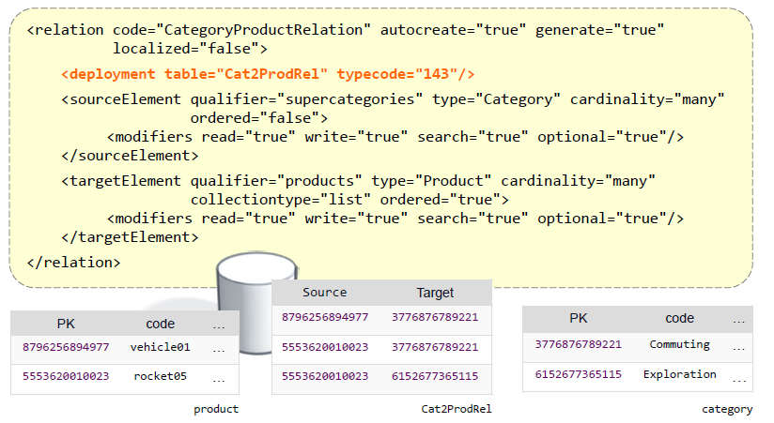
Deployment Cont..
Object Relational Mapping – Deployment of Relations Many– Many
New database table which holds the source and target PKs

Slide 41
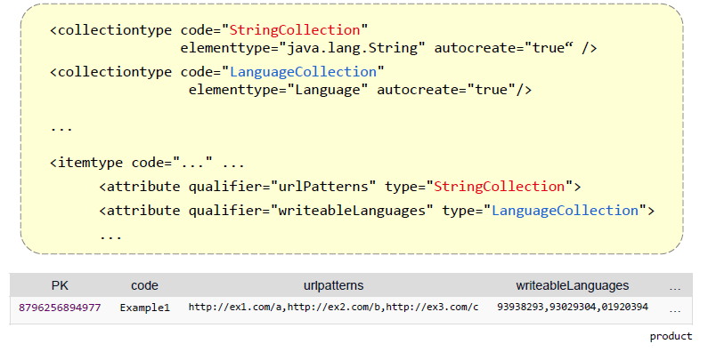
Deployment Cont..
Object Relational Mapping – Deployment of Collections
Stored in one database column
Comma separated list of PKs or Atomic Values

Slide 42
References
https://wiki.hybris.com/display/release5/Type+System+Documentation
https://wiki.hybris.com/display/release5/items.xml
https://wiki.hybris.com/display/release4/Specifying+a+Deployment+for+hybris+Platform+Types
https://wiki.hybris.com/display/release5/ Specifying+a+Deployment+for+hybris+Platform+Types

Slide 43
Thank You

